Slide 1

Plant Disease Detection using Deep Learning
Nathan Abela
Institute of Information & Communication Technology
MCAST, Paola, Malta

Slide 2
Problem Definition
Plant diseases are responsible for 20-40% of global crop loss per year [1].
Amounting to over $220 billion annually [1].
Detection systems aid in early disease identification.
Led to the Precision Agriculture (PA) technology creation [2].
Notes:
Economically, $220 billion each year – highlighting the urgency and importance of addressing this issue
This led to the precision agriculture technology creation within the agriculture sector

Slide 3
Literature - Datasets
Dataset | No. of Images | No. of Classes | Resolution
PlantVillage | 54,303 | 38 | 256x256
PlantDoc | 2,598 | 17 | Various
PlantLeaves | 4,503 | 17 | 6000x4000
PlantNet-300K | 306,146 | 1,081 | 600x600
Table 1: Dataset Comparison
Notes:
PlantVillage is a key dataset in computer vision based plant disease detection being the most popular one in PA

Slide 4
Literature – Key Papers
Dataset – PlantVillage – all 38 classes
Models – EfficientNet – VGG16
Study | Classifier | Accuracy
Atila et al. [3] | EfficientNet | 99.97%
Mohameth et al. [4] | VGG16 | 97.82%
Table 2: Results Comparison between two key papers
Notes:
Start by stating that looking at 2 key papers from various papers
Atila et al:
Dataset – PlantVillage – all 38 classes – 2 versions
Model – EfficientNet – EfficientNetB4
Approach - Effectiveness of EfficientNet
Utilised the PlantVillage dataset with both original and augmented versions
Proposed to evaluate the effectiveness of EfficientNet against other state-of-the-art models, such as, GoogLeNet/VGG16, from 8 versions of EfficientNet, the EfficientNetB4 achieved highest
Reliability - Detailed experimental methods ensure that the study's findings can be replicated
Validity - uses standardized metrics
Strengths – rigorous quantitative approach, detailed comparison analysis
Mohameth:
Dataset – PlantVillage – all 38 classes
Models – ResNet50, VGG16, GoogLeNet
Approach – Effectiveness of CNNs combined with transfer learning
Utilised the PlantVillage dataset – original set only
Proposed to evaluate the effectiveness of different CNNs combined with transfer learning
Methodology discrepancies found number of images for Apple class listed as 33,172 when it was 3,172, Squash classes listed as two classes when there’s only 1 class in the dataset
Reliability – using a well-known dataset
Real-World Applicability: Testing the models in real-world scenarios enhancing the external validity of the study

Slide 5
Literature – Local Contributions
Aspect | Galdes [5] | Busutill [6] | Mercieca [7] | Xuereb [8]
Detection Type | Disease | Disease | Crop & Disease | Disease
Datasets | PlantVillage | PlantVillage | PlantVillage & Custom | PlantVillage
Plants | Tomato | Potato | Apples, Grapes & Potatoes | Various
Classes | 10 | 3 | 11 | 15
Algorithm | XGBoost + VGG16 | YOLOv5 | VGG16 | GoogLeNet & AlexNet
Accuracy | 91% | 98.5% | 98.67% | 95% & 78%
Table 3: Summary comparison of local research contribution
Notes:
Section to highlight research efforts in plant disease detection at a local level
Xuereb took one plant from each class, still 15 classes out of 38 classes
Standard algorithms rather than state-of-the-art
Mercieca crop detection in terms of classifying the type of plant only

Slide 6
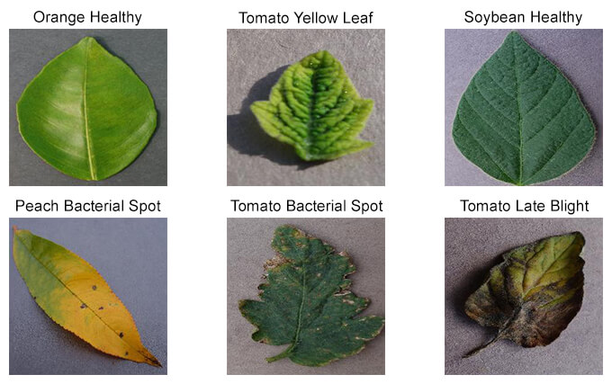
Methodology – Hypothesis
This research hypothesises that recent advancements in deep learning models, particularly CNNs, permit a more holistic and accurate detection and classification of various plant diseases.

Slide 7
Methodology – Research Questions
1. How well can established deep learning methods for plant disease detection be replicated, and what strengths and weaknesses can be gained?
2. Can computer vision techniques differentiate between healthy and diseased plants?
3. How can an experimentation plan help advance plant disease detection?
4. How do variations in CNN architecture affect the efficiency of the model?
Notes:
These are short versions of the research questions:
1. How effectively can established deep learning methodologies from key research papers be replicated for plant disease detection? What insights can be gained from this process regarding the strengths and limitations of existing approaches?
2. Can computer vision techniques accurately identify key characteristics that differentiate healthy plants from those infected with various diseases?
3.How can an experimentation plan help identify model architecture variations to advance plant disease detection?
4. How do variations in CNN architecture, such as layers, filter sizes, and pooling strategies, affect the accuracy of plant disease detection?

Slide 8
Methodology – Research Questions
5. What impact do different hyperparameters have on the performance of deep-learning models for plant disease detection?
6. How does the proposed solution perform with key local crops?
Notes:
5. What impact do different hyperparameters, like learning rate and batch size, have on the performance of deep learning models for plant disease detection?
6. How does the proposed solution perform on the detection of key and important local crops?

Slide 9
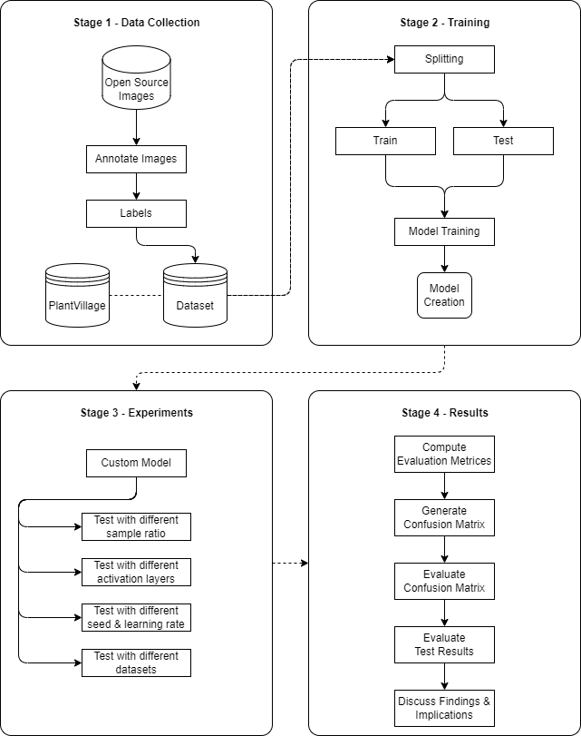
Methodology – Novel Pipeline

Slide 10
Methodology - Experiments
Phase 1:
Calibration
Replicating key methodologies from two key papers Atila et al. [3] and Mohameth et al. [4]
Phase 2:
Novel
Custom deep-learning algorithm using insights gained from calibration phase
Phase 3:
Real-World Application
Testing custom dataset using custom algorithm
Use of Grad-CAM to visualise model under real-world conditions

Slide 11
Results – Calibration Phase
Calibration Experiments – Replication of Methodologies from Key Papers [RQ 1]
Study | Atila et al. [3] | Atila et al. Replication | Mohameth et al. [4] | Mohameth et al. Replication
Accuracy | 99.84% | 95.86% | 97.82% | 95.64%
Precision | 97.24% | 96.33% | N/A | 96.64%
Recall | 96.82% | 95.55% | N/A | 94.71%
F1-Score | N/A | 95.94% | 96.42% | 95.66%
Table 4: Results comparison of the replicated methodologies and the original studies using the
PlantVillage dataset
Notes:
Results comparison of the replicated methodologies and against the original studies using the PlantVillage dataset
Minimal performance difference of approximately 2% difference
- Difference in Mohameth et al is due to the researchers not mentioning the split ratio

Slide 12
Results – Novel Phase
Novel Experiments – Custom Algorithm [RQ 3, 4 & 5]
Study | Custom Algorithm
Accuracy | 81.01%
Precision | 85.21%
Recall | 78.27%
F1-Score | 81.59%
Table 5: Results summary of the Custom model using the PlantVillage dataset
Notes:
Novel:
It's evident from this experiment, as well as supported by other papers that higher training ratios can indeed result in improved accuracy on the test dataset. This occurs because a larger training set provides more comprehensive coverage of the variability in data, while a smaller test set might not fully challenge the model's capabilities, potentially leading to an overestimation of its performance.
The performance of the custom model was quantified by averaging results across 10 seed values to stabilise outcomes against random initialisation effects

Slide 13
Results – Real-World Application Phase
Real-World Application Experiments – Custom Dataset [RQ 2, 3 & 6]
Study | Custom Dataset
Accuracy | 85.13%
Precision | 91.94%
Recall | 81.82%
F1-Score | 86.13%
Table 6: Results summary of the Custom model using the Custom dataset

Slide 14
Custom Dataset Overview
Class | Plant | Healthy or Diseased | Disease Name | Type of Disease | No. of Images
C_1 | Potato | Diseased | Late Blight | Fungal | 80
C_2 | Potato | Healthy | / | / | 80
C_3 | Strawberry | Diseased | Leaf Scorch | Fungal | 80
C_4 | Strawberry | Healthy | / | / | 80
C_5 | Tomato | Diseased | Yellow Leaf | Viral | 80
C_6 | Tomato | Healthy | / | / | 80
Table 7: Class breakdown of the Custom dataset
Notes:
- 3 Key Crops in Malta - Potatoes, Strawberries, and Tomatoes
- Balanced Dataset – 80 images with 6 classes – 480 images

Slide 15
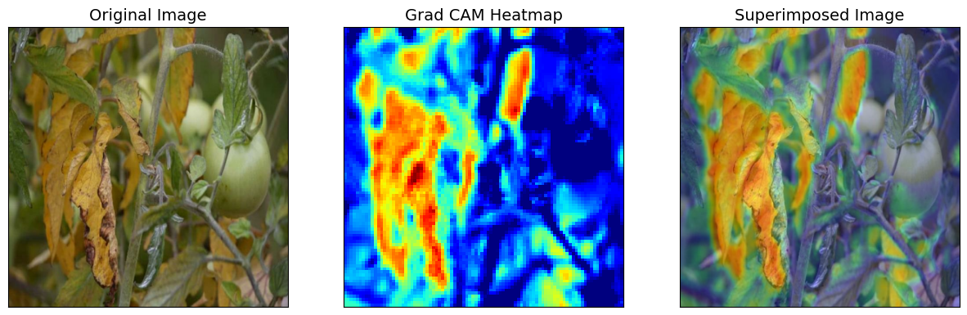
Custom Dataset Evaluation

Slide 16
Research Question Evaluation
How well can established deep learning methods for plant disease detection be replicated, and what strengths and weaknesses can be gained?
Effective and Successful replication.
Can computer vision techniques differentiate between healthy and diseased plants?
CV techniques can distinguish between healthy and diseased crops.
How does the proposed solution perform with key local crops?
Despite lack of diversity in custom dataset, the outcome does address such.

Slide 17
Research Question Evaluation
How can an experimentation plan help advance plant disease detection?
How do variations in CNN architecture affect the efficiency of the model?
What impact do different hyperparameters have on the performance of deep-learning models for plant disease detection?
With an experimentation plan insights were gathered on how hyperparameters and various CNN architecture contribute and their effect.

Slide 18
Conclusions - Limitations
Absence of locally sourced images – limits study validity
Custom dataset sourced from online sources rather than local fields.
Seasonal availability of the diseased leaves.
Notes:
Despite collaboration with ERA and AGRIHUB Malta there is a lack of images in relation to crops in Malta

Slide 19
Conclusions - Recommendations
Prioritise the development of a more representative local dataset.
Collaboration with local farmers and agricultural organisations.
More advanced neural network architectures that require less computational power to be used in real-time applications.
Notes:
Prioritize the development of a more representative dataset, including images directly sourced from Maltese fields, this can be done by collaborating with local farmers or agricultural organizations

Slide 20
References
[1] H. Canton, “Food and agriculture organization of the united nations-fao”, in The Europa directory of international organizations 2021. Routledge, 2021, pp. 297–305.
[2] S. Candiago, F. Remondino, M. De Giglio, M. Dubbini, and M. Gattelli, “Evaluating multispectral images and vegetation indices for precision farming applications from uav images,” Remote Sensing, vol. 7, no. 4, pp. 4026–4047, 04 2015.
[3] Umit Atila, Murat Uc¸ar, Kemal Akyol, and Emine Uc¸ar. Plant leaf disease classification using efficientnet deep learning model. Ecological Informatics, 61:101182, 03 2021.

Slide 21
References
[4] Faye Mohameth, Chen Bingcai, and Kane Amath Sada. Plant disease detection with deep learning and feature extraction using plant village. Journal of Computer and Communications, 08:10–22, 01 2020.
[5] Dylan Galdes. Comparing image classification methods for tomato plant disease detection. Bachelor of Science (Honours) in Software Development, 06 2021.
[6] Jasmine Busuttil. Identifying plant diseases using yolov5. Bachelor of Science (Honours) in Software Development, 06 2022.

Slide 22
References
[7] Robert Mercieca. Using convolutional neural networks to identify different plants and common diseases associated with them. Bachelor of Science (Honours) in Software Development, 05 2022.
[8] Melchior Xuereb. Plant diseases: Investigating how they can be detected and identified using ai. Bachelor of Science (Honours) in Software Development, 06 2020.

Slide 23
Thank you Nathan Abela nathan.abela.e25765@mcast.edu.mt

